Slide 1
Tutorial 1 Learning Topology Optimization Through Examples and Case Studies
August 18, 2019

Slide 2
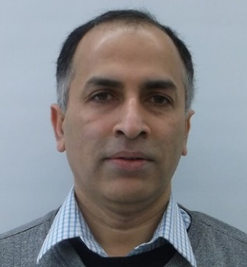
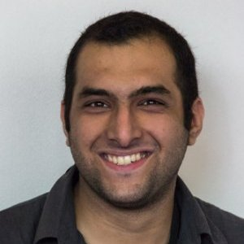
Intros
Philip and Jean Myers Professor
Department of Mechanical Engineering
University of Wisconsin-Madison
ksuresh@wisc.edu
www.ersl.wisc.edu
Attendees Intro!
Krishnan Suresh
Research Scientist
Palo Alto Research Center (PARC)
amirzend@parc.com
Amir M. Mirzendehdel
PhD Student
University of Wisconsin-Madison
scsubedi@wisc.edu
www.ersl.wisc.edu
Subodh C Subedi

Slide 3
Scope of Workshop
Hands-on introduction to Topology Optimization (TO)
Overview of TO Methods (SIMP & Pareto)
Sensitivity concepts for research
Performance and manufacturing constraints
Numerous examples and case-studies
Working through Problems
Not a research survey!
Slides will be made available to attendees

Slide 4
Agenda
Time | Agenda
9:00 AM - 10:30 AM | Intros, Software Setup, Testing
10:30 AM - 11:00 AM | Topology Optimization Methods
11:00 AM - 11:15 AM | Discussion/Coffee Break
11:15 AM - 12:00 PM | Pareto method of Optimization
12:00 PM - 12:45 PM | Lunch Break
1:00 PM - 2:00 PM | Multi Load, Multi Body, Multi Physics
2:00 PM - 2:15 PM | Discussion/Coffee Break
2:15 PM - 2:30 PM | TopOpt for AM
2:30 PM - 4:30 PM | Challenge Problems

Slide 5
Next Steps …
Logistics
All the contents for this workshop are available to download at
www.ersl.wisc.edu
Workshop slides
Software setup
Check the Pareto User Guide 2019.06
Questions?

Slide 6
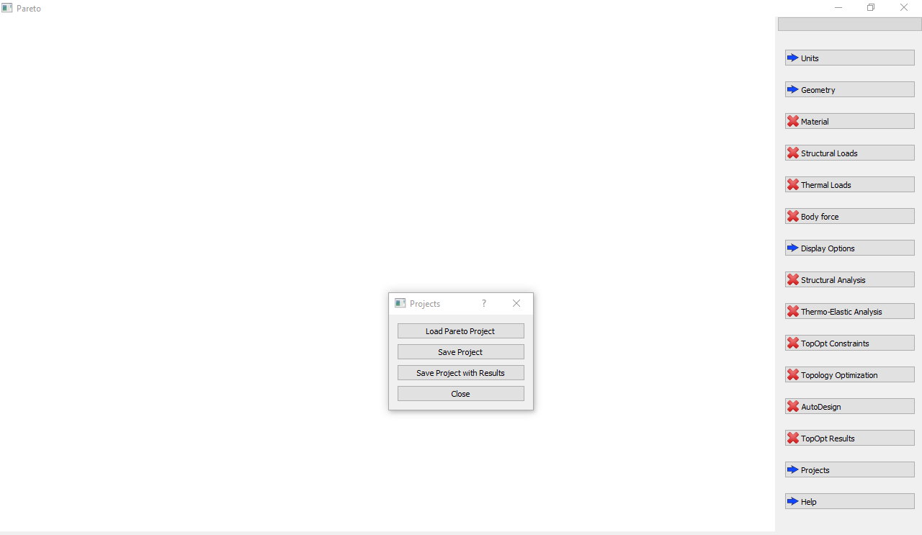
Software Test
Load project
1
Navigate to the ParetoExamples folder on your Desktop
2
Select CantileverBeamProject.prj

Slide 7
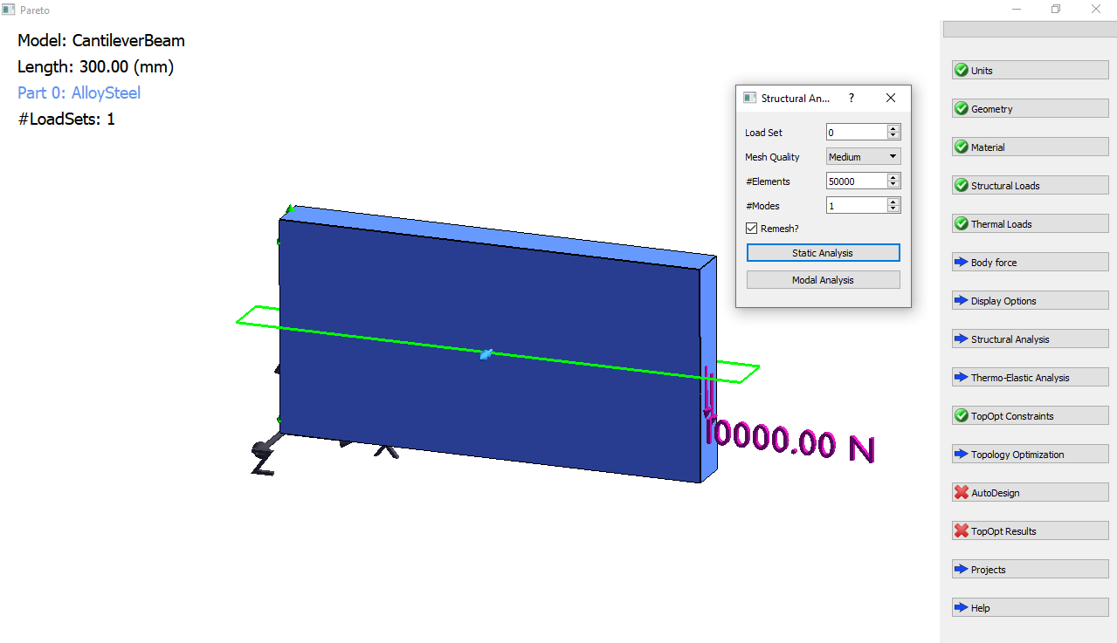
FEA
2
1

Slide 8
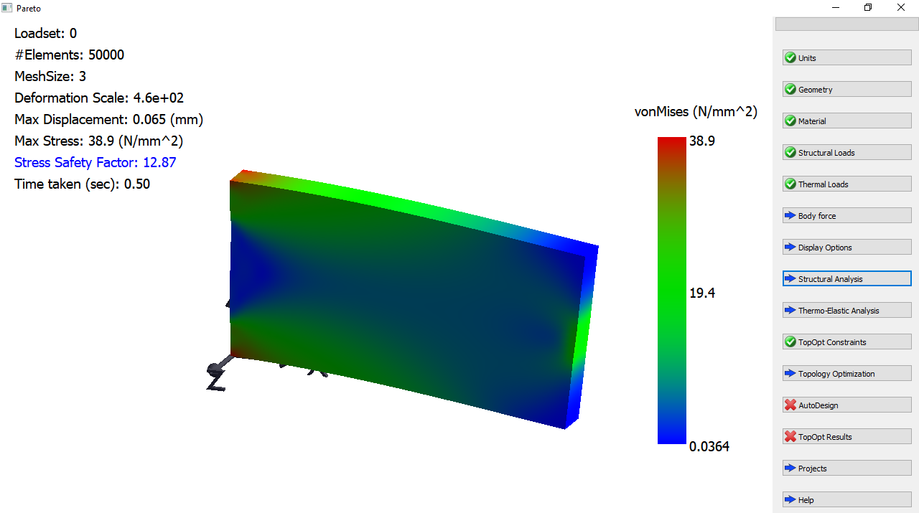
FEA Results

Slide 9
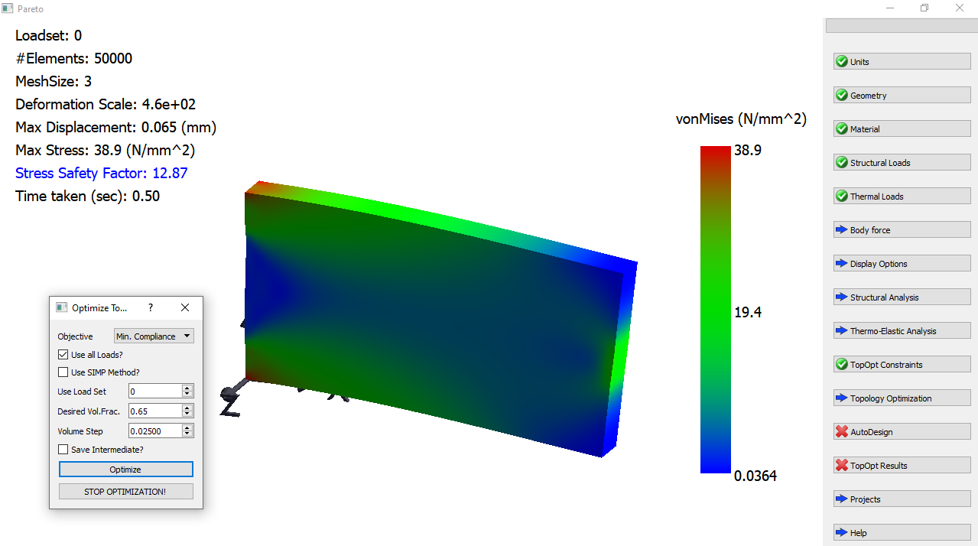
Optimize
1
2

Slide 10
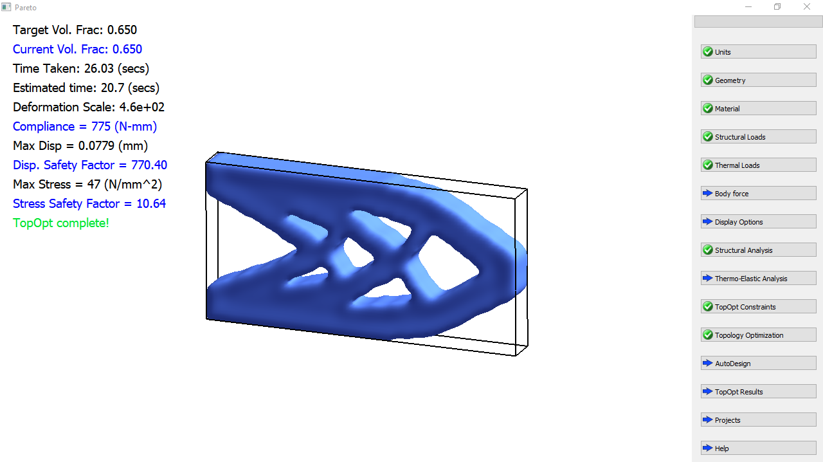
Optimization_Results
Success!

